Slide 1

iOS Programing with Swift (Part III)
CSIE, National Dong Hwa University
Shou-Chih Lo
2021

Slide 2

Reference Book
Beginning iOS 14 Programming with Swift, Simon Ng: https://www.appcoda.com/swift/
iOS App程式開發實務攻略：快速精通iOS 14程式設計, Simon Ng: 博碩文化股份有限公司

Slide 3
Table Row Deletion, Custom Action Button
Chapter 12

Slide 4
Table Row Deletion
1. Enable the swipe-to-delete feature so that the user can select the Delete option
2. Delete the corresponding table data from the data model
3. Reflect the change of table data

Slide 5
Enable Editable Table Cells
Using the UITableViewDiffableDataSource, we need to create a subclass
Model > New file > “DiffableDataSource”
enum Section {
case all
}
class DiffableDataSource: UITableViewDiffableDataSource<Section, Restaurant> {
override func tableView(_ tableView: UITableView, canEditRowAt indexPath: IndexPath) -> Bool {
return true
}
}
Move the Section declaration here
Notes:
enum Section {
case all
}
class DiffableDataSource: UITableViewDiffableDataSource<Section, Restaurant> {
override func tableView(_ tableView: UITableView, canEditRowAt indexPath: IndexPath) -> Bool {
return true
}
}
//********************
//Cannot move canEditRowAt func to the RestaurantTableViewController
//UITableViewDiffableDataSource has implement this func and return false by default

Slide 6
Enable Editable Table Cells
TableViewController
Update the codes in configureDataSource()
func configureDataSource() -> DiffableDataSource {
let cellIdentifier = "datacell"
let dataSource = DiffableDataSource (
…
)

Slide 7
UIContextualAction: Swipe for More Actions
Two methods for handling swipe actions in table view cells:
swipe-to-right: tableView(_:leadingSwipeActionsConfigurationForRowAt:)
swipe-to-left: tableView(_:trailingSwipeActionsConfigurationForRowAt:)

Slide 8
Swipe for More Actions
// Get the selected restaurant
guard let restaurant = self.dataSource.itemIdentifier(for: indexPath) else {
return UISwipeActionsConfiguration()
}
// Delete action
let deleteAction = UIContextualAction(…, title: "Delete") { (…) in
var snapshot = self.dataSource.snapshot() //current snapshot
snapshot.deleteItems([restaurant]) //delete the restaurant from snapshot
self.restaurants.remove(at: indexPath.row) //delete the restaurant from array
self.dataSource.apply(snapshot, animatingDifferences: true)
// Call completion handler to dismiss the action button
}
Notes:
//delete causes the constraint problem: top margin priority to 750
override func tableView(_ tableView: UITableView, trailingSwipeActionsConfigurationForRowAt indexPath: IndexPath) -> UISwipeActionsConfiguration? {
// Get the selected restaurant
guard let restaurant = self.dataSource.itemIdentifier(for: indexPath) else {
return UISwipeActionsConfiguration()
}
// Delete action
let deleteAction = UIContextualAction(style: .destructive, title: "Delete") { (action, sourceView, completionHandler) in
//delete from the table view (datasource and source array are separated: structure type)
var snapshot = self.dataSource.snapshot()
snapshot.deleteItems([restaurant])
self.dataSource.apply(snapshot, animatingDifferences: true)
//delete from the source array
self.restaurants.remove(at: indexPath.row)
// Call completion handler to dismiss the action button
completionHandler(true)
}
// Share action
let shareAction = UIContextualAction(style: .normal, title: "Share") { (action, sourceView, completionHandler) in
let defaultText = "Just checking in at " + restaurant.name
let imageToShare = UIImage(named: restaurant.image)! //make sure always have the image
let activityController: UIActivityViewController
activityController = UIActivityViewController(activityItems: [defaultText, imageToShare], applicationActivities: nil)
//popover solution code
self.present(activityController, animated: true, completion: nil)
completionHandler(true)
}
// Change the action's color and icon
// Configure both actions as swipe action
let swipeConfiguration = UISwipeActionsConfiguration(actions: [deleteAction, shareAction])
return swipeConfiguration
}

Slide 9
Swipe for More Actions
// Share action
let shareAction = UIContextualAction(…, title: "Share") { (…) in
let defaultText = ". . . "
let imageToShare = UIImage(named: restaurant.image)
let activityController = UIActivityViewController(activityItems: [defaultText, imageToShare], …)
// Solution codes for the popover problem on iPad
self.present(activityController, animated: true, completion: nil)
completionHandler(true)
}

Slide 10
Sharing Content
The UIActivityViewController class provides several standard services, such as copying items to the clipboard, sharing content on social media sites, sending items via Messages, etc.
Deal with the popover problem on iPad for UIActivityViewController
Notes:
// For iPad
if let popoverController = activityController.popoverPresentationController {
if let cell = tableView.cellForRow(at: indexPath) {
popoverController.sourceView = cell
popoverController.sourceRect = cell.bounds
}
}

Slide 11
Customize UIContextualAction
Customize the action button’s style including background color and icon
deleteAction.backgroundColor = UIColor.systemRed
deleteAction.image = UIImage(systemName: "trash")
shareAction.backgroundColor = UIColor.systemOrange
shareAction.image = UIImage(systemName: "square.and.arrow.up")
//SF Symbols
Notes:
deleteAction.backgroundColor = UIColor.systemRed
deleteAction.image = UIImage(systemName: "trash")
shareAction.backgroundColor = UIColor.systemOrange
shareAction.image = UIImage(systemName: "square.and.arrow.up")

Slide 12
Your Challenge
Provide a swipe-to-right action to add/remove favorites
override func tableView(…, leadingSwipeActionsConfigurationForRowAt …) -> UISwipeActionsConfiguration? {
let favoriteAction = UIContextualAction(…, title: “Add to favorites") { (. . .) in
…
completionHandler(true)
}
let swipeConfiguration = UISwipeActionsConfiguration(actions: [favoriteAction])
return swipeConfiguration
}
Notes:
override func tableView(_ tableView: UITableView, leadingSwipeActionsConfigurationForRowAt indexPath: IndexPath) -> UISwipeActionsConfiguration? {
// Mark as favorite action
let favoriteAction = UIContextualAction(style: .destructive, title: "") { (action, sourceView, completionHandler) in
let cell = tableView.cellForRow(at: indexPath) as! TableViewCell
//update source array
self.restaurants[indexPath.row].isFavorite = self.restaurants[indexPath.row].isFavorite ? false : true
//update data source of the tableview
var snapshot = NSDiffableDataSourceSnapshot<Section, Restaurant>()
snapshot.appendSections([.all])
snapshot.appendItems(self.restaurants, toSection: .all)
self.dataSource.apply(snapshot, animatingDifferences: false)
//update cell
cell.accessoryType = self.restaurants[indexPath.row].isFavorite ? .checkmark : .none
// Call completion handler to dismiss the action button
completionHandler(true)
}
// Change the action's color and icon
favoriteAction.backgroundColor = UIColor.systemYellow
favoriteAction.image = UIImage(systemName: self.restaurants[indexPath.row].isFavorite ? "heart.slash.fill" : "heart.fill")
let swipeConfiguration = UISwipeActionsConfiguration(actions: [favoriteAction])
return swipeConfiguration
}

Slide 13
Extra: Make Real Phone Calls
var phoneNumber = “12345678”
if let phoneURL = URL(string: "tel://\(phoneNumber)"), UIApplication.shared.canOpenURL(phoneURL) {
UIApplication.shared.open(phoneURL, options: [:], completionHandler: nil)
}
Test on a real device only!!

Slide 14
Summary
The cell item deletion in this sample app is performed directly on the snapshot, not on the original data array (restaurants)
Related APIs
Get the current snapshot: snapshot = self.dataSource.snapshot()
Get all the items from the snapshot: snapshot.itemIdentifiers //item array
Get the ItemIdentifier at indexPath: self.dataSource.itemIdentifer(for: indexPath)

Slide 15
Summary
Delete one certain item: snapshot.deleteItems([ItemIdentifier])
Insert one certain item: snapshot.insertItems([ItemIdentifier], afterItem (or BeforeItem): ItemIdentifier
Update one certain item: insert the new item after the old item, and then delete the old item
Update one certain item (for class objects only): call reloadItems([updatedItem])
Notes:
Reference: https://swiftsenpai.com/development/modern-ways-reload-cells/

Slide 16
Introduction to Navigation Controller and Segue
Chapter 13

Slide 17
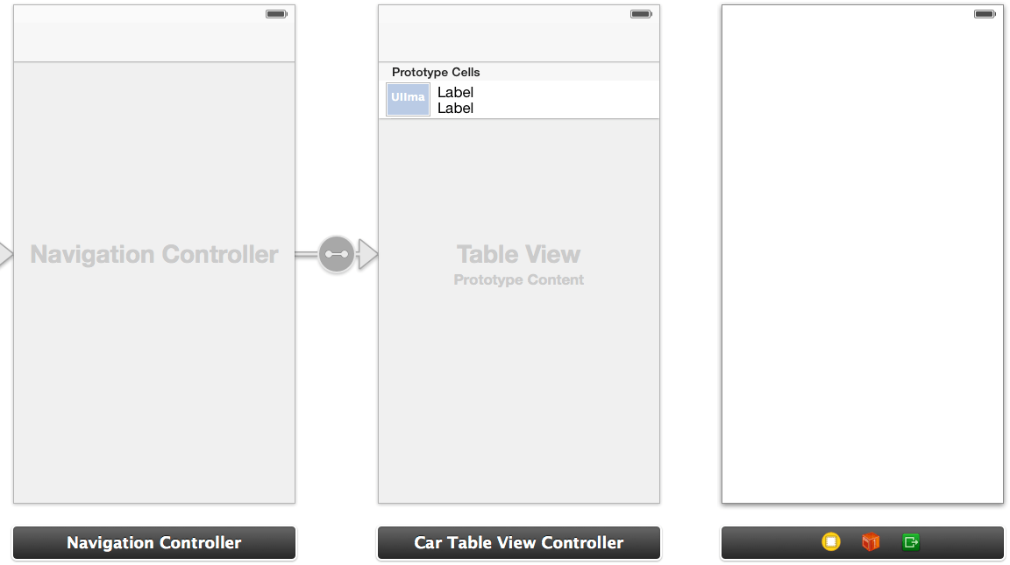
Navigation Controller
Provide scene changes for manage hierarchical content
For example, combine a navigation controller with a stack of table view controllers

Slide 18
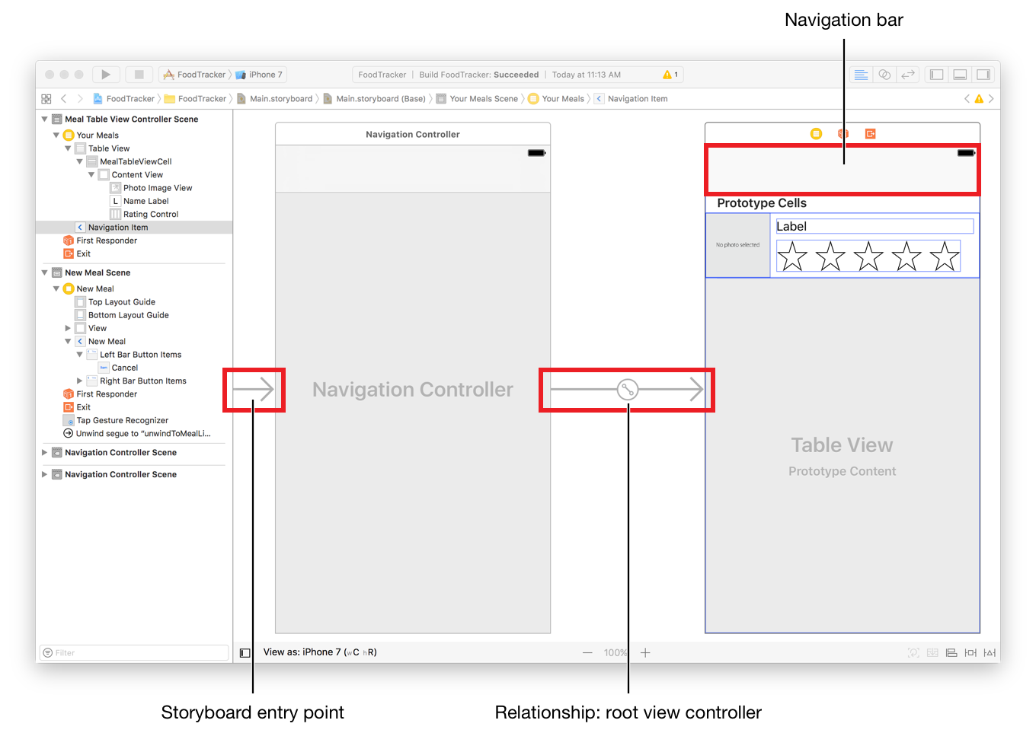
Navigation Controller
Select the Table view controller and click Editor in the menu.
Choose Embed in > Navigation Controller
Select the navigation item under the Table view controller, and change the title to FoodPin

Slide 19
Enable Large Titles
viewDidLoad() of TableViewController
navigationController?.navigationBar.prefersLargeTitles = true
Notes:
navigationController?.navigationBar.prefersLargeTitles = true

Slide 20
Add View Controller
Add a new view controller that displays the restaurant details
Drag an Image View to fit the view controller
Spacing constraints to 0 for each side
Content Mode: Aspect Fill

Slide 21
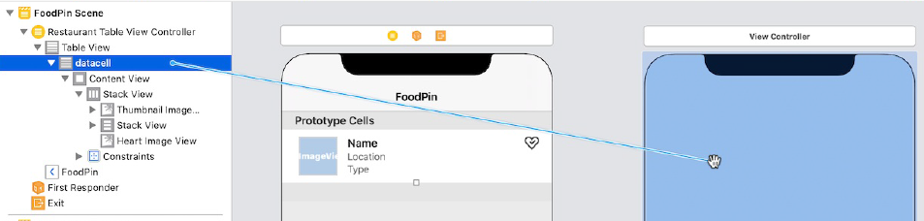
Create Segue
Transit to the detail scene when a user taps a cell
The transition between two scenes is called segue
Create a connection from the prototype cell to the detailed view controller
Select "Show"

Slide 22
Types of Segue
Show - content view is pushed on top of the current view controller stack. A back button is displayed in the navigation bar
Show detail - content view replaces the top of the current view controller stack. (no navigation bar and back button)
Present modally – content view is animated up from the bottom and cover the entire screen on iPhone (no navigation bar and back button)
Present as popover - present the content view as a popover anchored to an existing view (no navigation bar and back button)

Slide 23
Types of Segue
Show (similar to pushViewController)
View Controller A
View Controller B
Back (similar to popViewController)
Present
View Controller A
View Controller B
Close (call the dismiss method)

Slide 24
New Class for Detail View
(Before that) remove the tableView(_:didSelectRowAt:) method from TableViewController.swift
(or) Select the block of code and press command+slash
Create a new class file: DetailViewController, as a subclass of UIViewController
Assign this class to the detail view controller

Slide 25
New Class for Detail View
restaurantImageName for image data passing
restaurantImageView for the image view
Establish the connection of the restaurantImageView variable
Notes:
@IBOutlet var restaurantImageView: UIImageView!
var restaurantImageName = ""

Slide 26
Passing Data Using Segues
DetailViewController.swift
A segue manages the transition between view controllers, and contains the view controllers involved in the transition
Notes:
restaurantImageView.image = UIImage(named: restaurantImageName)

Slide 27
Passing Data Using Segues
Before the visual transition occurs, the storyboard notifies the source view controller by calling the prepare(for: sender:) method
Here you can pass any relevant data to the destination controller
Give each segue a unique identifier first
Select the segue in the storyboard
Set the identifier to showDetail

Slide 28
Passing Data Using Segues
TableViewController.swift
override func prepare(for segue: UIStoryboardSegue, sender: Any?) {
if segue.identifier == "showDetail" {
if let indexPath = tableView.indexPathForSelectedRow {
let destinationController = segue.destination as! DetailViewController
destinationController.restaurantImageName = restaurants[indexPath.row].image
}
}
}
Access properties but not view objects
Notes:
override func prepare(for segue: UIStoryboardSegue, sender: Any?) {
if segue.identifier == "showDetail" {
if let indexPath = tableView.indexPathForSelectedRow {
let destinationController = segue.destination as! DetailViewController
destinationController.restaurantImageName = restaurants[indexPath.row].image
}
}
}

Slide 29
Disable Large Titles
viewDidLoad() of DetailViewController

Slide 30
Passing the Restaurant Object
DetailViewController
var restaurant = Restaurant()
prepare() in TableViewController
destinationController.restaurant = restaurants[indexPath.row]

Slide 31
Summary
A navigation controller is suitable for a series of scene changes
Config each segue with an identifier name and a suitable type
Call the prepare method where the data can be passed before a segue is performed

Slide 32
Detail View Enhancement and Navigation Bar Customization
Chapter 14

Slide 33
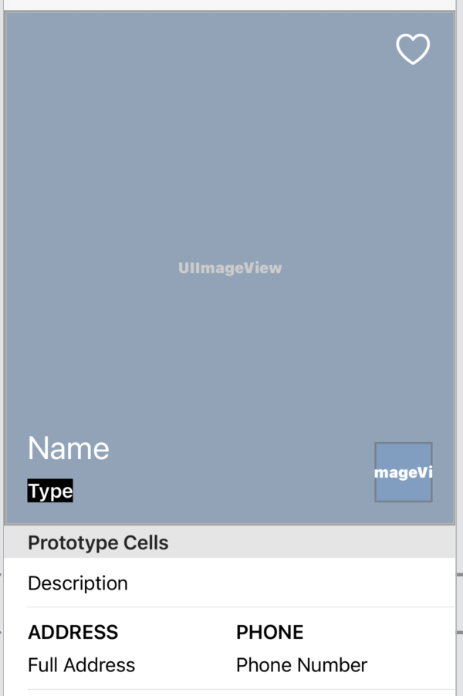
Dynamic Table View
Re-design the restaurant detail view
Create a custom table view with multiple prototype cells
Each prototype cell is associated with a customized class file with IBOutlet variables
Header View
Prototype Cell 1
Prototype Cell 2

Slide 34
Dynamic Table View
Drag a table view to fit the whole view
Spacing to 0 for each side
Prototype cells: 2
Add a new view before the prototype cells
Height: 445 points
Rename: Header View

Slide 35
Dynamic Table View
Drag an image view into the header view
Content Mode: Aspect Fill
Name: Header Image View
Spacing to 0 for each side
Constrain to margins option is unchecked

Slide 36
Dynamic Table View
Add a label
Color: white
Font: Title 1
Text: Name
Name: Name Label

Slide 37
Dynamic Table View
Drag another label
Background color: black
Font color: white, Font: Headline, Alignment: center
Text: Type
Name: Type Label

Slide 38
Dynamic Table View
Drag a button to the upper-right corner
Title: none
Image: heart
Tint: white
Default Symbol Configuration: Configuration: Point Size, Point size: 30
Name: Heart Button

Slide 39
Add Layout Constraints
Heart Button
Top, Right: 10, 10
Width, Height: Fixed
Name Label and Type Label
Embed into stack: Spacing = 10, Alignment: leading
Left, Right, Bottom: 20, 150, 20

Slide 40
Add Program Codes
Create a new file: DetailHeaderView, subclass: UIView
Declare IBOutlet variables
@IBOutlet var headerImageView: UIImageView!
@IBOutlet var nameLabel: UILabel!
@IBOutlet var typeLabel: UILabel!
@IBOutlet var heartButton: UIButton!
Notes:
@IBOutlet var headerImageView: UIImageView!
@IBOutlet var nameLabel: UILabel!
@IBOutlet var typeLabel: UILabel!
@IBOutlet var heartButton: UIButton!

Slide 41
Add Program Codes
Select the Header View
Custom class: DetailHeaderView
Establish a connection with each of the corresponding outlet variables

Slide 42
Add Program Codes
DetailViewController.swift
Connect these outlets with the corresponding UI components
Notes:
@IBOutlet var tableView: UITableView!
@IBOutlet var headerView: DetailHeaderView!

Slide 43
Add Program Codes
viewDidLoad() in DetailViewController.swift
// Configure header view
headerView.nameLabel.text = restaurant.name
headerView.typeLabel.text = restaurant.type
headerView.headerImageView.image = UIImage(named: restaurant.image)
let heartImage = restaurant.isFavorite ? "heart.fill" : "heart"
headerView.heartButton.tintColor = restaurant.isFavorite ? .systemYellow : .white
headerView.heartButton.setImage(UIImage(systemName: heartImage), for: .normal)
Notes:
// Configure header view
headerView.nameLabel.text = restaurant.name
headerView.typeLabel.text = restaurant.type
headerView.headerImageView.image = UIImage(named: restaurant.image)
let heartImage = restaurant.isFavorite ? "heart.fill" : "heart"
headerView.heartButton.tintColor = restaurant.isFavorite ? .systemYellow : .white
headerView.heartButton.setImage(UIImage(systemName: heartImage), for: .normal)

Slide 44
Improve the Layout
Enable multi-line texts
Select the name label and set the Lines option to be 0
(Or) in DetailHeaderView.swift

Slide 45
Improve the Layout
Add an overlay view to dim the image
Drag a view below the header image view in document outline
Name: Dim View
Background color: black, alpha: 0.2
Spacing to 0 for each side (Before: resize the dim view across the stack view)

Slide 46
Design the Prototype Cell 1
Drag a label
Name: Description, Font style: Body
Spacing: top, left, bottom and right side to 0 , 0 , 0 and 0 (enable Constraint to margin)
(Create a new class file for this prototype cell)
DetailTextCell, subclass: UITableViewCell
Connect this outlet variable to the description label
@IBOutlet var descriptionLabel: UILabel! {
didSet {
descriptionLabel.numberOfLines = 0
}
}
Notes:
@IBOutlet var descriptionLabel: UILabel! {
didSet {
descriptionLabel.numberOfLines = 0
}
}

Slide 47
Design the Prototype Cell 1
First prototype cell
Identifier: DetailTextCell
Custom class: DetailTextCell
Having the same name for easy coding, for example
get the identifier name from the class name itself:
String(describing: DetailTextCell.self)

Slide 48
Design the Prototype Cell 2
Temporarily increase the row height
Drag a label: Address, Headline
Drag a label: Full Address, Body
Embed the above two labels in a vertical stack: Equal Spacing, Spacing = 8
Clone the stack view above: Phone, Phone Number
Embed the above two stack views: Top Alignment, Fill Equally, Spacing = 10, All margins to 0
Cell’s row heigh set to automatic

Slide 49
Design the Prototype Cell 2
DetailTwoColumnCell.swift
@IBOutlet var column1TitleLabel: UILabel! {
didSet {
column1TitleLabel.text = column1TitleLabel.text?.uppercased()
column1TitleLabel.numberOfLines = 0
}
}
@IBOutlet var column1TextLabel: UILabel! {
didSet { column1TextLabel.numberOfLines = 0 }
}
@IBOutlet var column2TitleLabel: UILabel! {
// similar to column1TitleLabel
}
@IBOutlet var column2TextLabel: UILabel! {
// similar to column1TextLabel
}
Notes:
@IBOutlet var column1TitleLabel: UILabel! {
didSet {
column1TitleLabel.text = column1TitleLabel.text?.uppercased()
column1TitleLabel.numberOfLines = 0
}
}
@IBOutlet var column1TextLabel: UILabel! {
didSet {
column1TextLabel.numberOfLines = 0
}
}
@IBOutlet var column2TitleLabel: UILabel! {
didSet {
column2TitleLabel.text = column2TitleLabel.text?.uppercased()
column2TitleLabel.numberOfLines = 0
}
}
@IBOutlet var column2TextLabel: UILabel! {
didSet {
column2TextLabel.numberOfLines = 0
}
}

Slide 50
Design the Prototype Cell 2
Remember to connect the outlet variables to the corresponding views
Second prototype cell
Identifier: DetailTwoColumnCell
Custom class: DetailTwoColumnCell

Slide 51
Populate Information to Cells
DetailViewController.swift
Using extension to add new specifications to a class
extension DetailViewController: UITableViewDataSource, UITableViewDelegate {
//Implement the required methods
}
Notes:
extension DetailViewController: UITableViewDataSource, UITableViewDelegate {
}

Slide 52
Populate Information to Cells
Set the number of rows
func tableView(_ tableView: UITableView, numberOfRowsInSection section: Int) -> Int {
return 2
}

Slide 53
Populate Information to Cells
func tableView(…, cellForRowAt indexPath: IndexPath) -> UITableViewCell {
switch indexPath.row {
case 0: //using prototype cell 1
// get a reusable celll as! DetailTextCell
//config cell data
return cell
case 1: //using prototype cell 2
// get a reusable celll as! DetailTwoColumnCell
//config cell data
return cell
default:
…
}
}
Notes:
func tableView(_ tableView: UITableView, cellForRowAt indexPath: IndexPath) -> UITableViewCell {
switch indexPath.row {
case 0:
let cell = tableView.dequeueReusableCell(withIdentifier: String(describing: DetailTextCell.self), for: indexPath) as! DetailTextCell
cell.descriptionLabel.text = restaurant.summary
//cell.selectionStyle = .none
return cell
case 1:
let cell = tableView.dequeueReusableCell(withIdentifier: String(describing: DetailTwoColumnCell.self), for: indexPath) as! DetailTwoColumnCell
cell.column1TitleLabel.text = "Address"
cell.column1TextLabel.text = restaurant.location
cell.column2TitleLabel.text = "Phone"
cell.column2TextLabel.text = restaurant.phone
//cell.selectionStyle = .none
return cell
default:
fatalError("Failed to instantiate the table view cell for detail view controller")
}
}

Slide 54
Populate Information to Cells
Enable delegate connection (through program codes)
viewDidLoad() of DetailViewController
Remove the separator of the table

Slide 55
Summary
When a class conforms to some delegate protocols, make sure to enable delegate connection either through the interface builder or program codes
navigationController: return the nearest ancestor’s UINatgationController

Slide 56
Navigation Bar Customization, Extensions and Dynamic Type
Chapter 15

Slide 57
Navigation Bar Customization

Slide 58
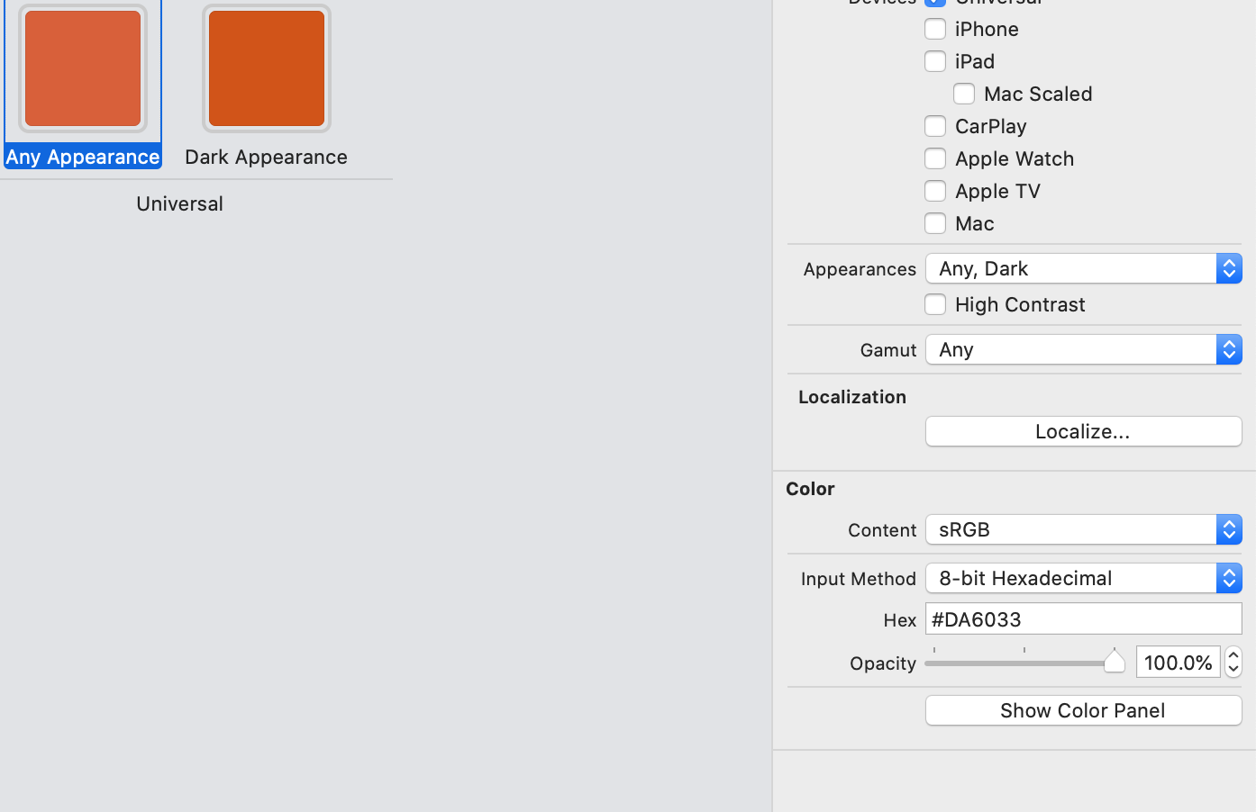
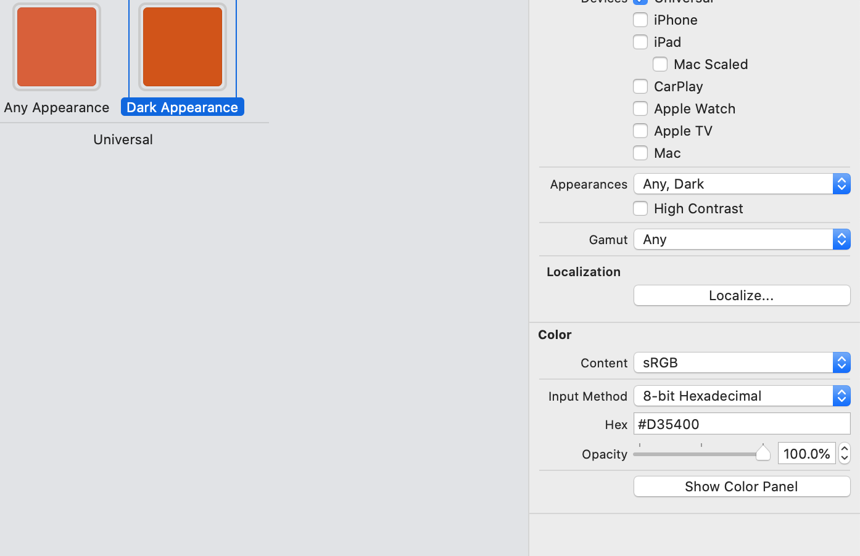
Define New Colors
Assets.xcassets > right-click > Color Set > NavigationBarTitle

